Slide 1
2019 DIP Project #2 Object Detection Using Viola-Jones detector
TEAM 7
Reader - 12141779_황성현
12141676_김승환
12141713_배동현
12171825_이승은

Slide 2
Contents
1. Overall Flow-chart
2. Descriptions of Datasets
3. Problems
-1) size of image: varying
-2) find the minimum detectable size of faces
-3) find the maximum detectable size of faces
-4) find the average detection time
(per image, per face)
-5) Performance Evaluation
4. Discussions
5. Team Activity

Slide 3
#1. Overall Flow-chart
Collect
Data
Crop ROI
Generate
Classifier
Training
By Cascade-Trainer GUI
Generate
Classifier
Load Xml file
Load
Image or Video
Using detectMultiScale()
For detection
Display Result
Evaluation
TRAINING
DETECT

Slide 4
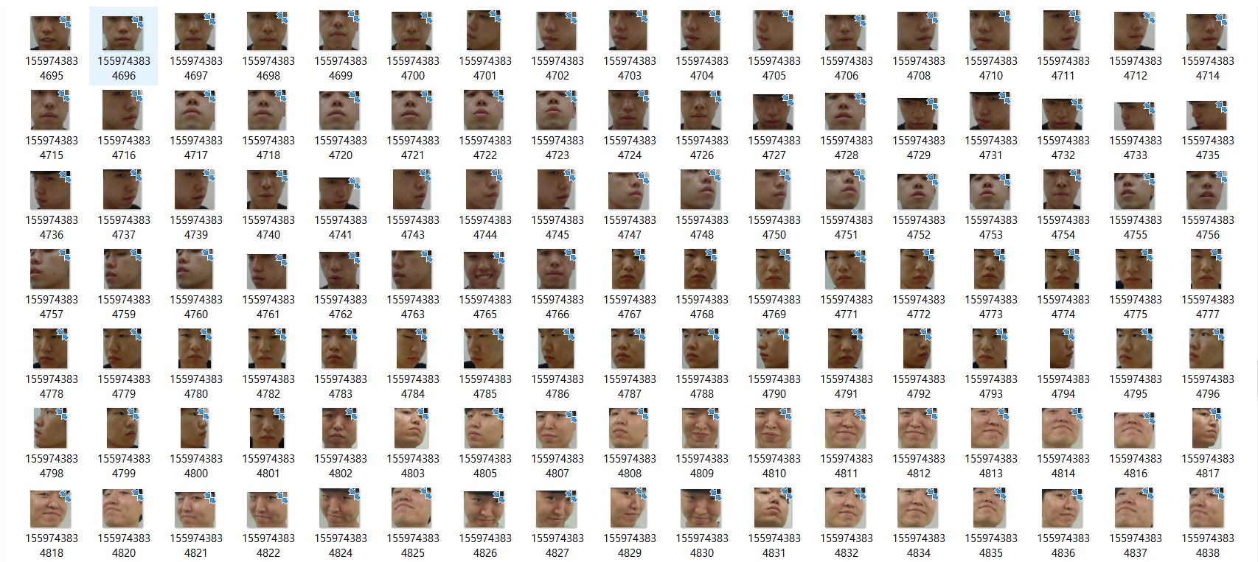
#Problem 1.(Face Detection)
Dataset
# of Positive | 2210
# of Negative | 21090
Width | 24
Height | 24
# of Stage | 14
Image Usage(%) | 85
Feature Type | HAAR
Source
http://zeus.robots.ox.ac.uk/vgg_face2/
http://pascal.inrialpes.fr/data/human/
https://drive.google.com/open?id=1cy2hma1uDiBKbeRXeBz6AMyg8M708vRx
https://www.shutterstock.com
https://www.unsplash.com
https://www.kaggle.com/
https://www.google.com
Our Photo

Slide 5
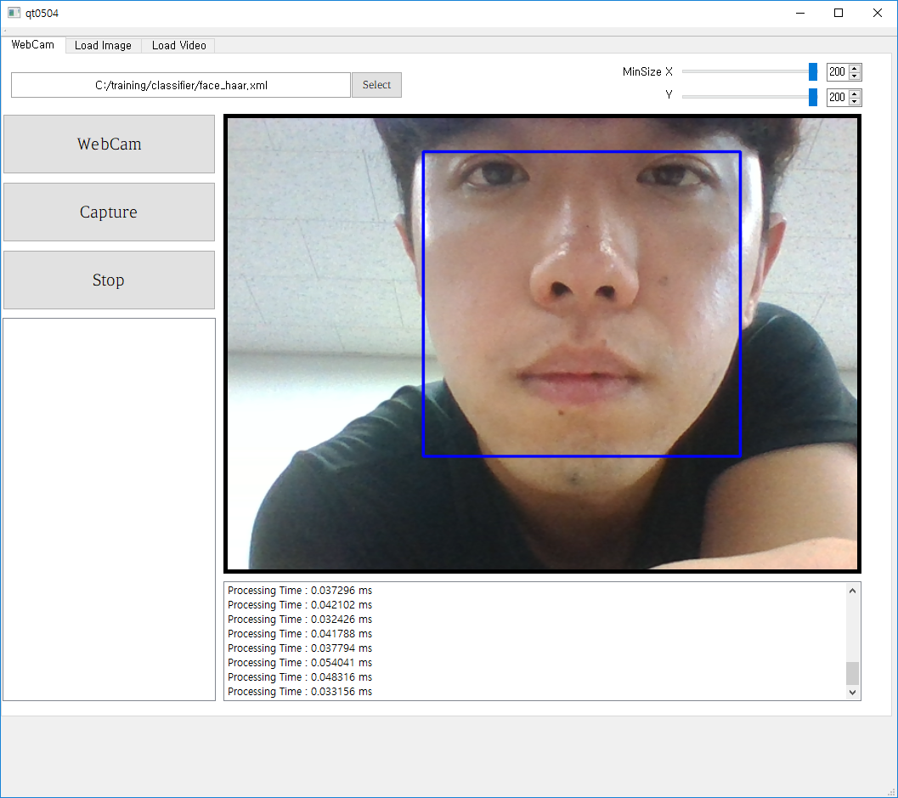
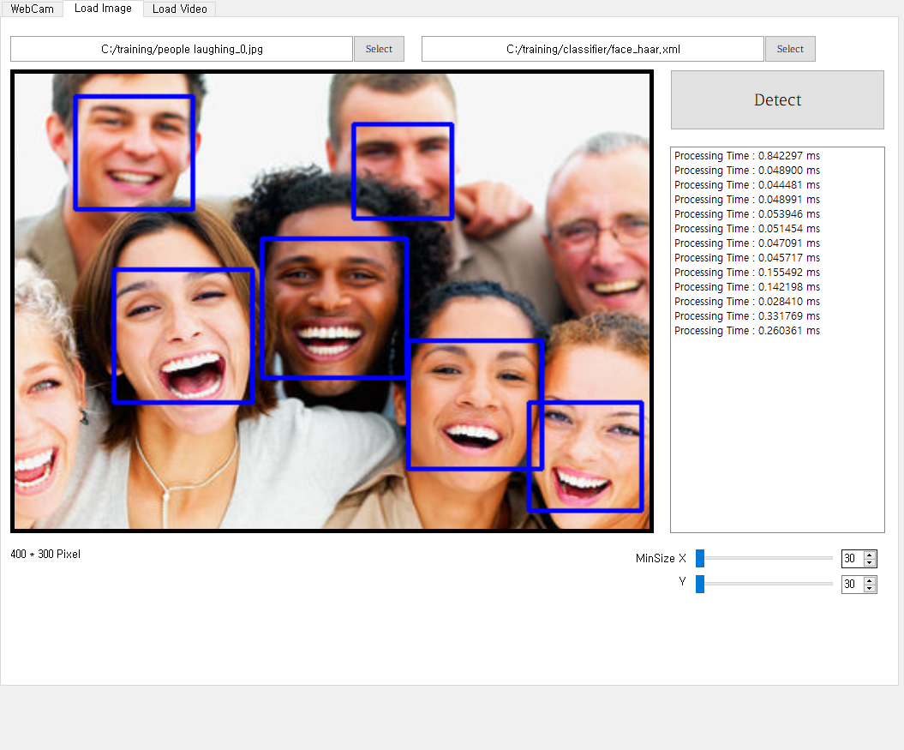
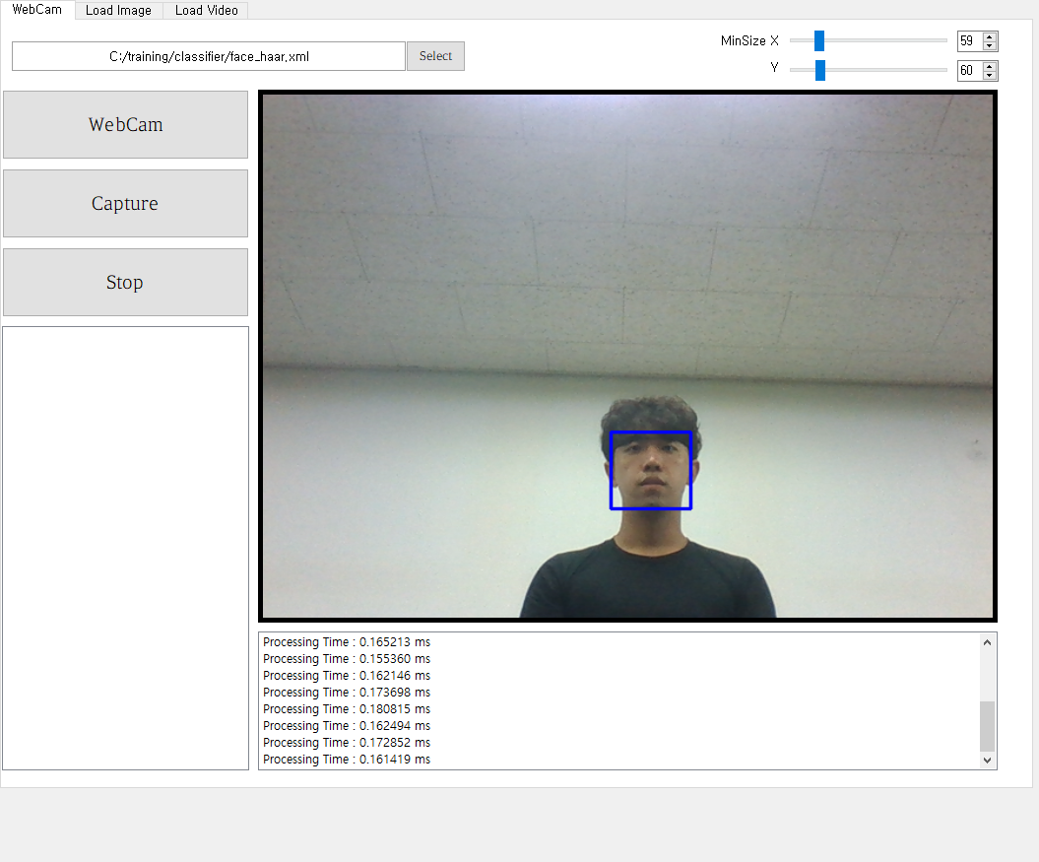
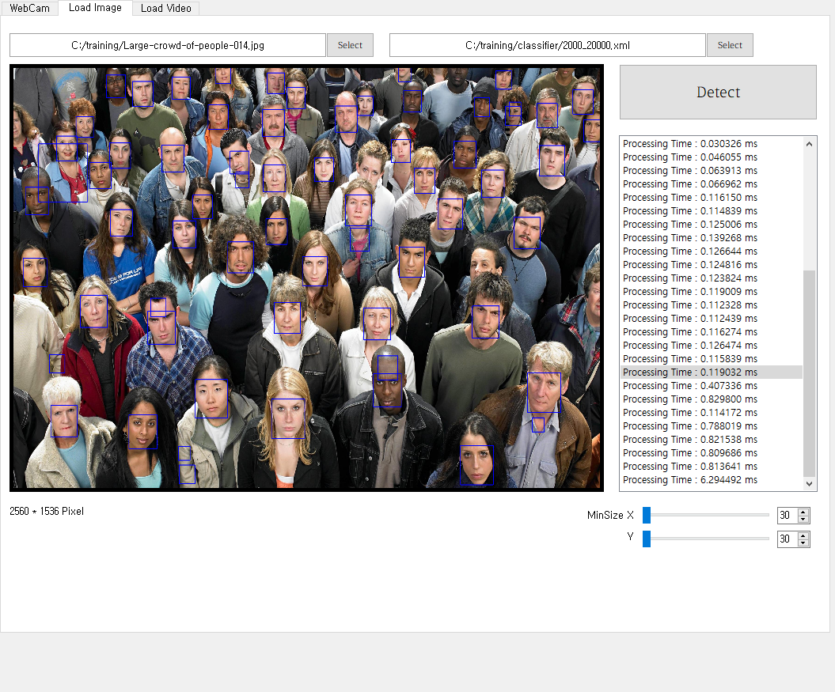
#Problem 1.(Face Detection)
Problem 1 & 2 & 3: Find the minimum and maximum detectable size of faces
Image Size | Minimum size of Detect scale | Minimum detectable size of faces | Maximum detectable size of faces | Average time
640 x 480(webcam) | 200 x 200 | 210 x 210 | 378 x 378 | 0.021751 s
640 x 480(webcam) | 100 x 100 | 105 x 105 |  | 0.086470 s
640 x 480(webcam) | 30 x 30 | 40 x 40 |  | 0.330037 s
400 x 300(Image) | 60 x 60 |  |  | 0.119032 s
2560 x 1536(Image) | 30 x 30 |  |  | 6.294492 s

Slide 6
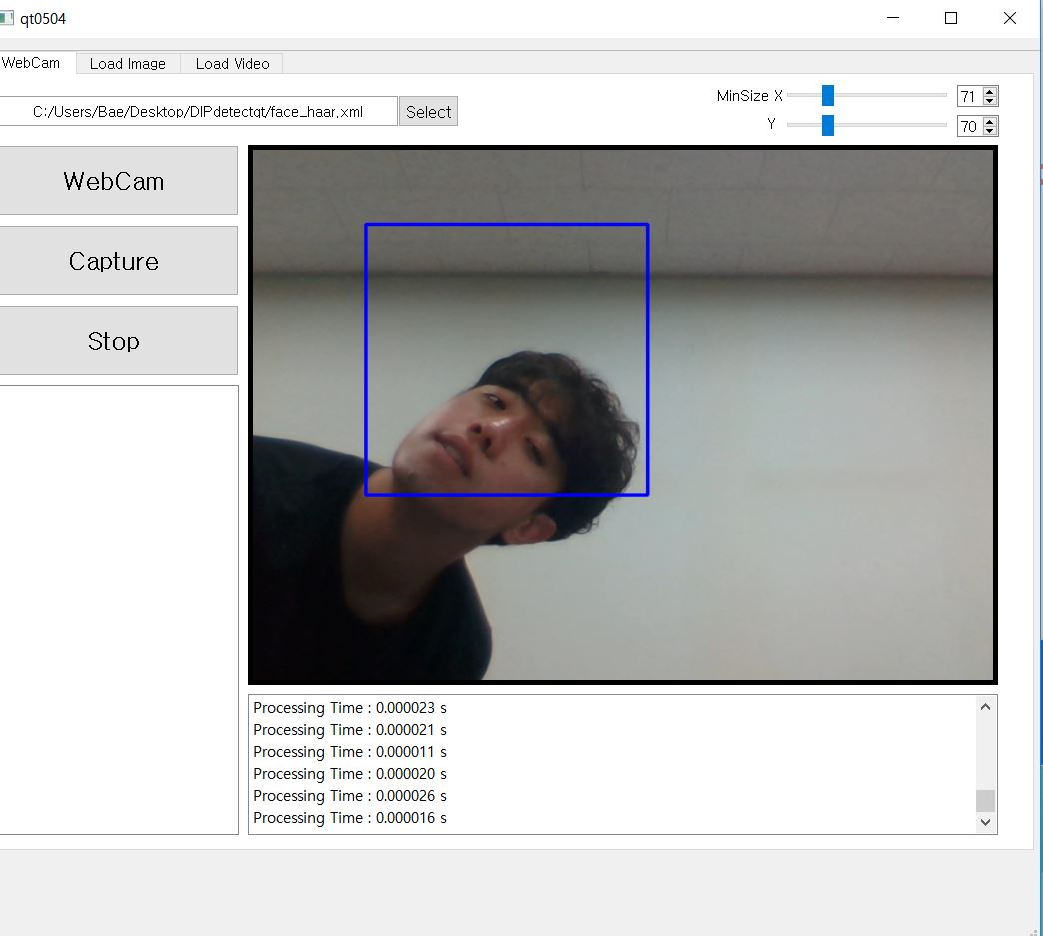
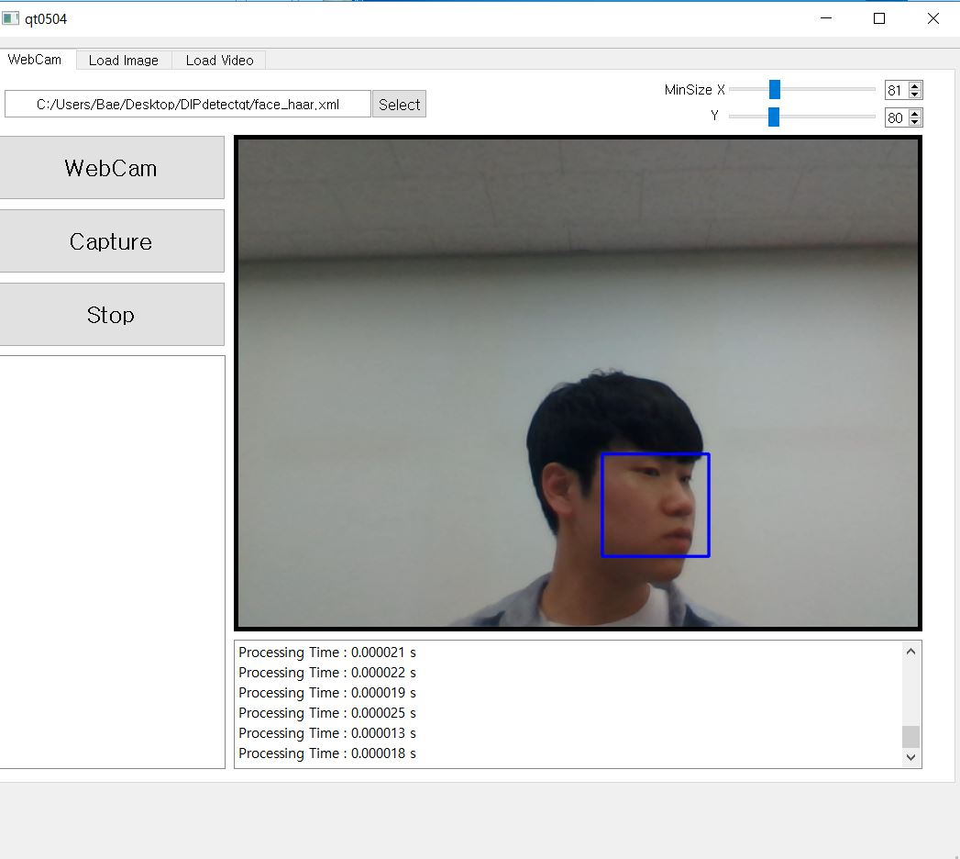
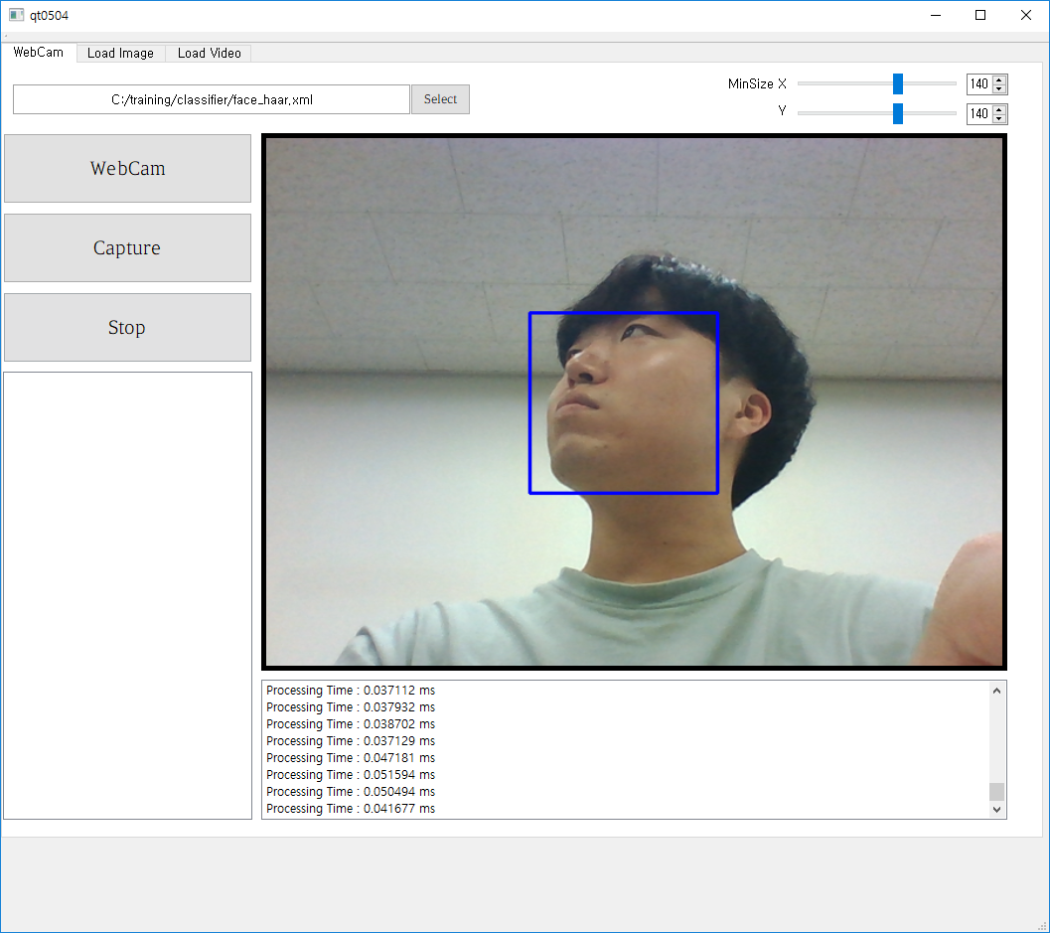
#Challenge #1 (Face Detection)
(View Point Variation)

Slide 7
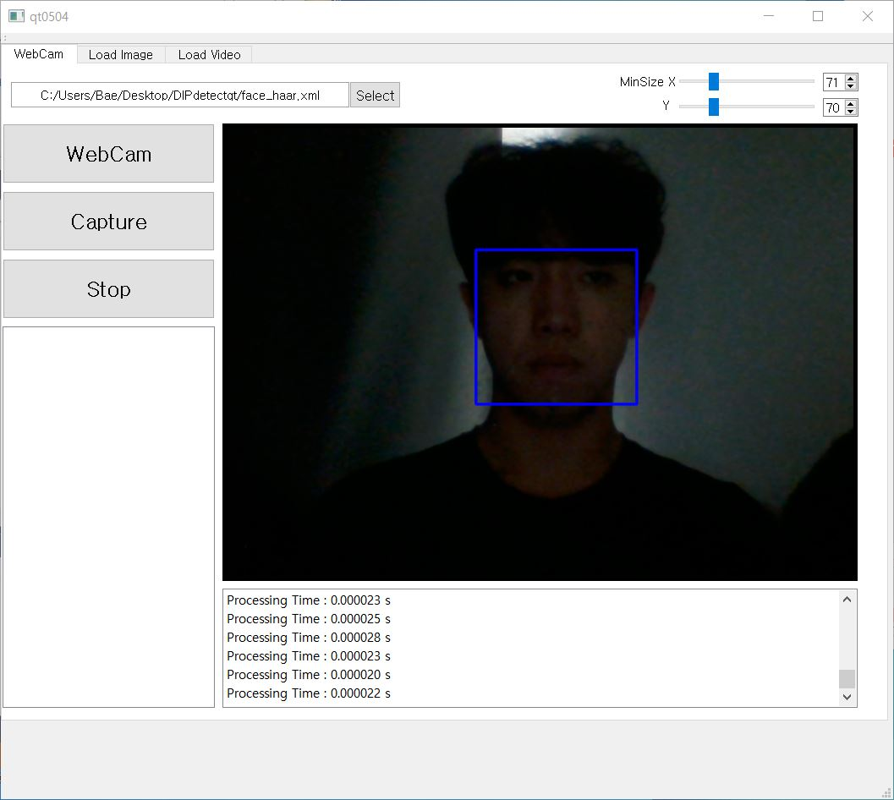
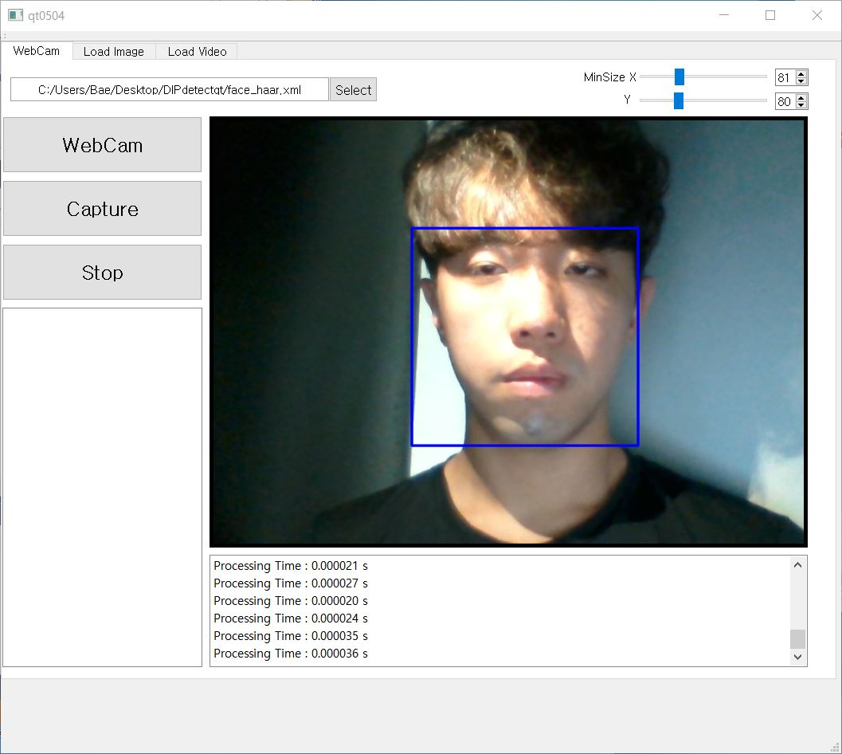
#Challenge #2 (Face Detection)
(Illumination)

Slide 8
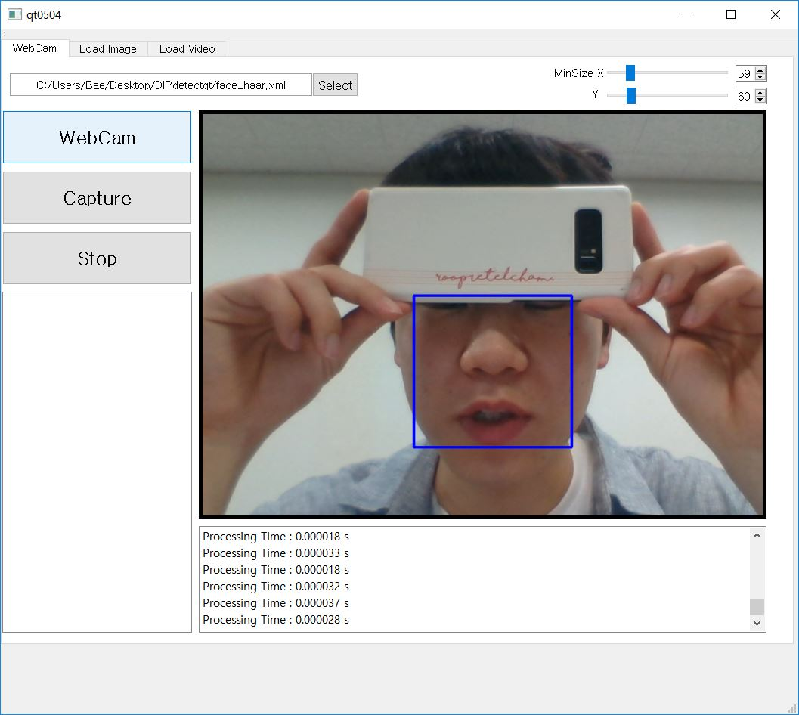
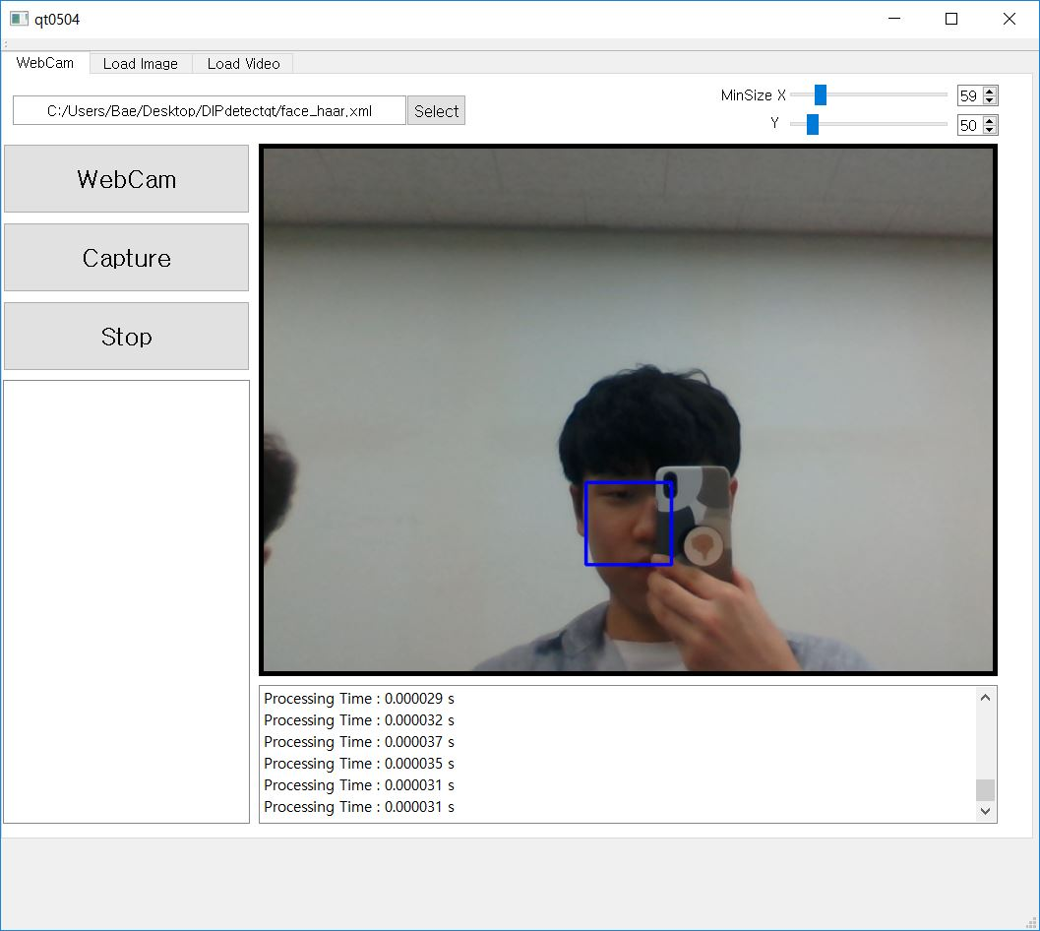
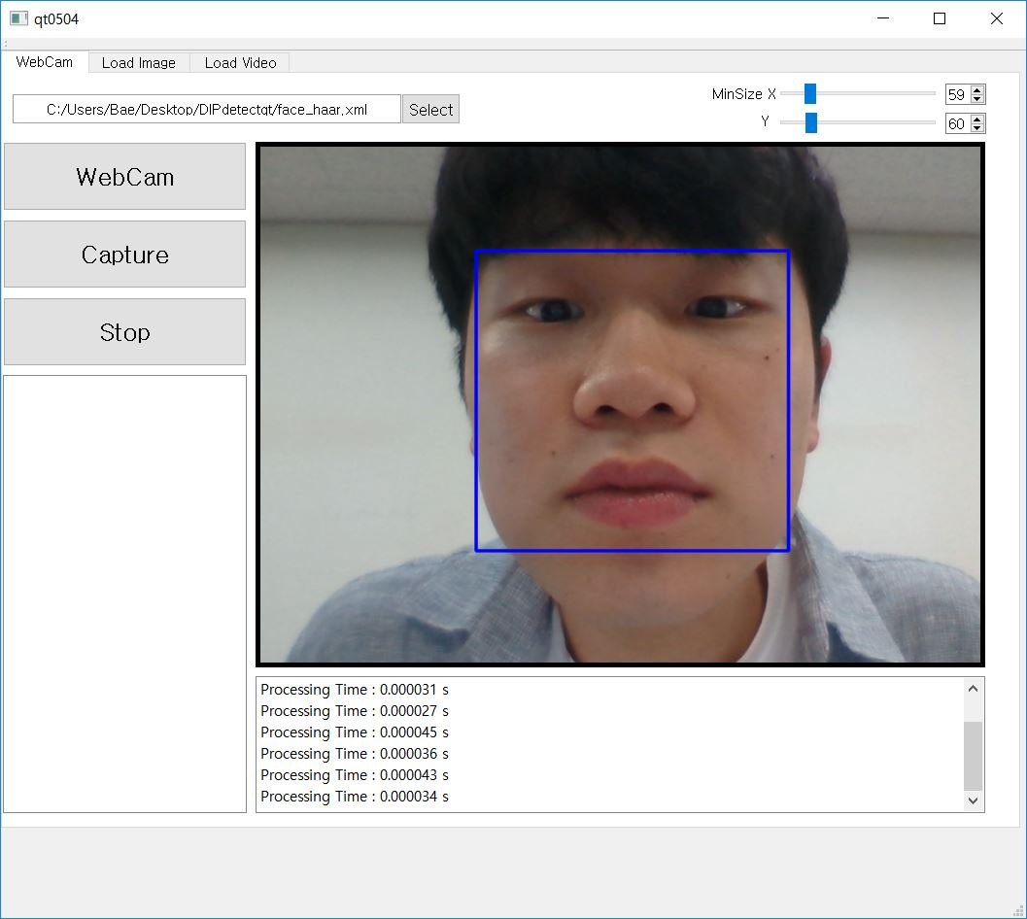
#Challenge #3 (Face Detection)
(Occlusion)

Slide 9
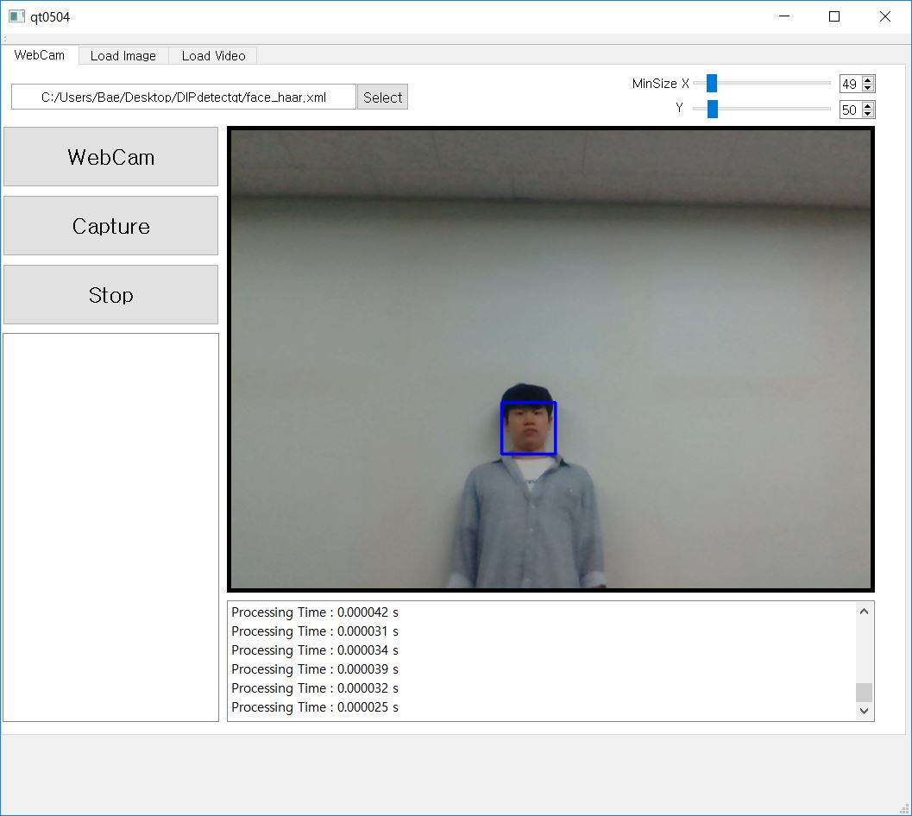
#Challenge #4 (Face Detection)
(Scale)

Slide 10
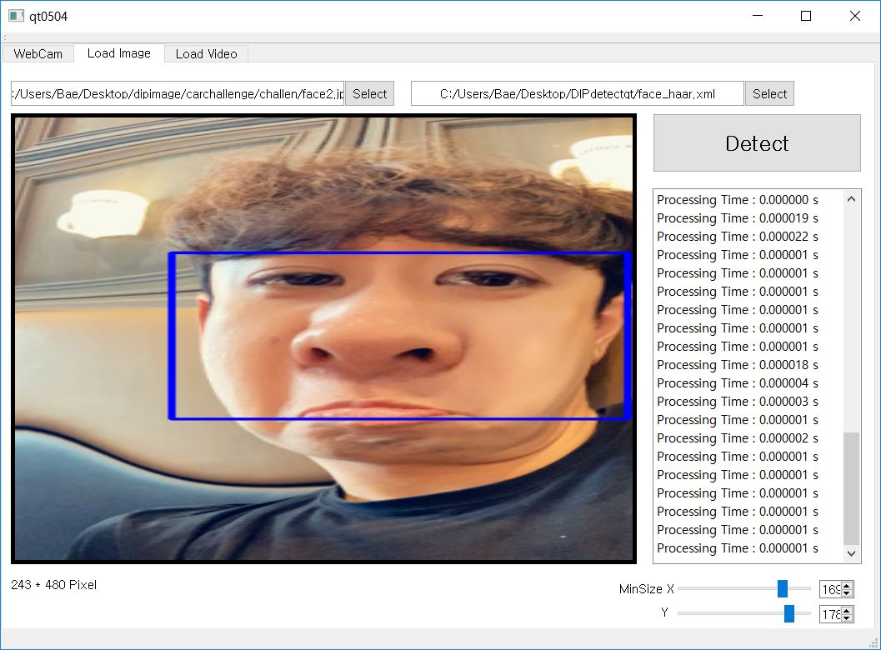
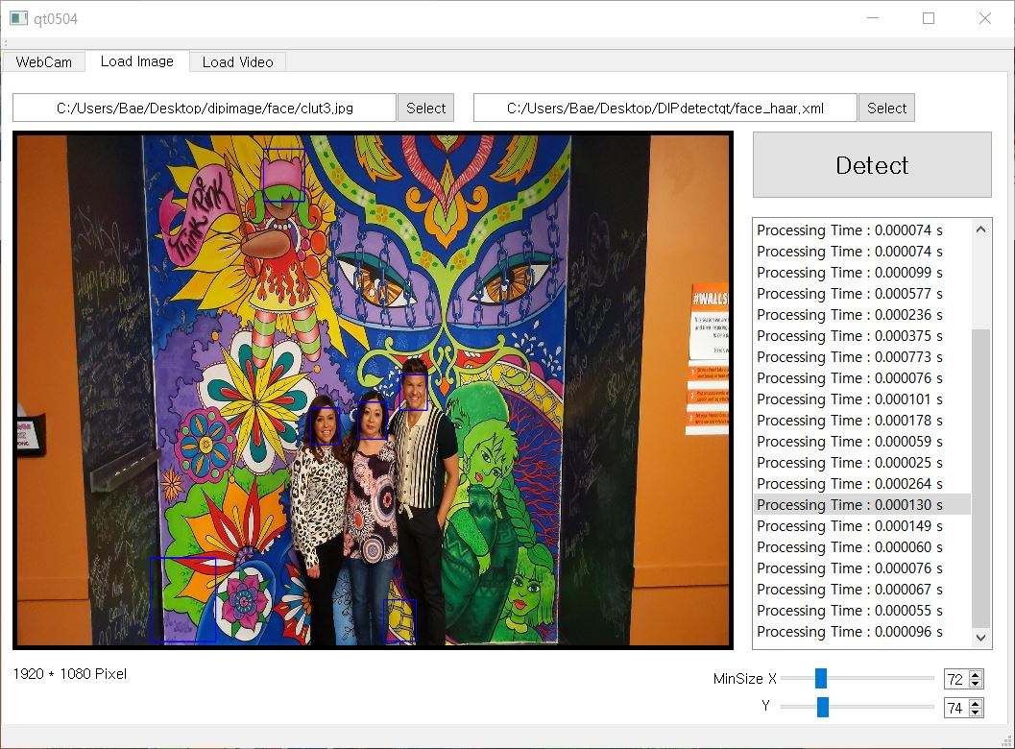
#Challenge #5 (Face Detection)
(Deformation)
#Challenge #6 (Face Detection)
(Background Clutter)

Slide 11
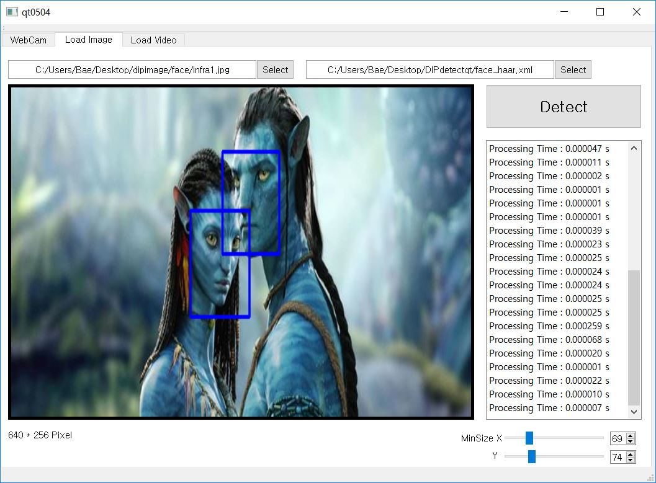
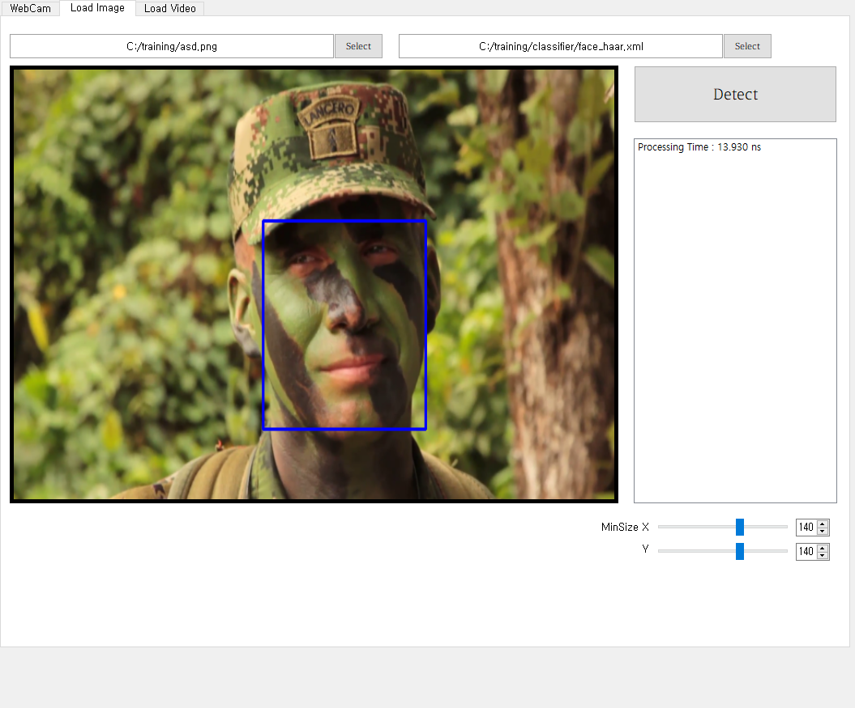
#Challenge #7 (Face Detection)
(Intra-Class Variation)
#Challenge #8 (Face Detection)
(Camouflaged)

Slide 12
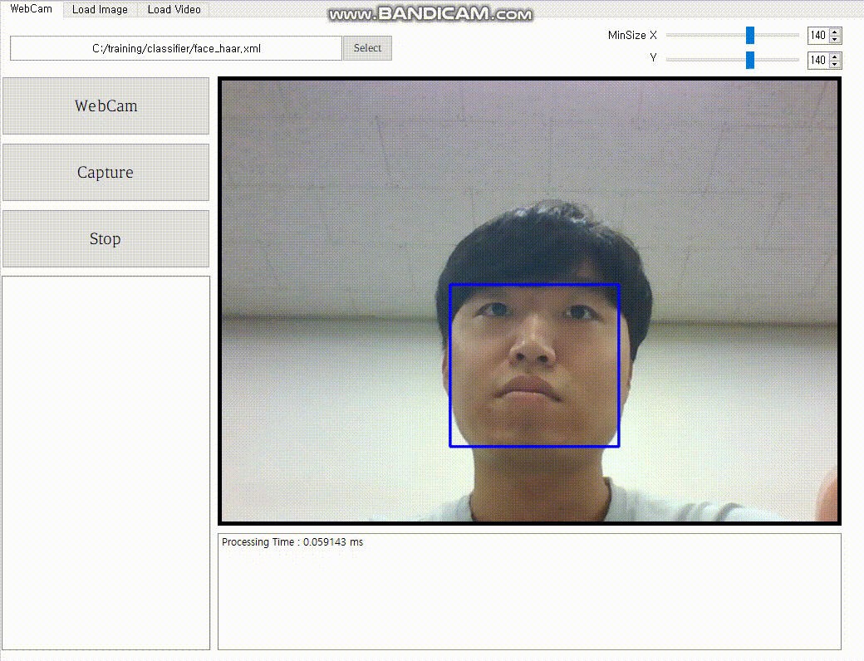
#Challenge #9 (Face Detection)
(Real-time Processing)
GIF

Slide 13
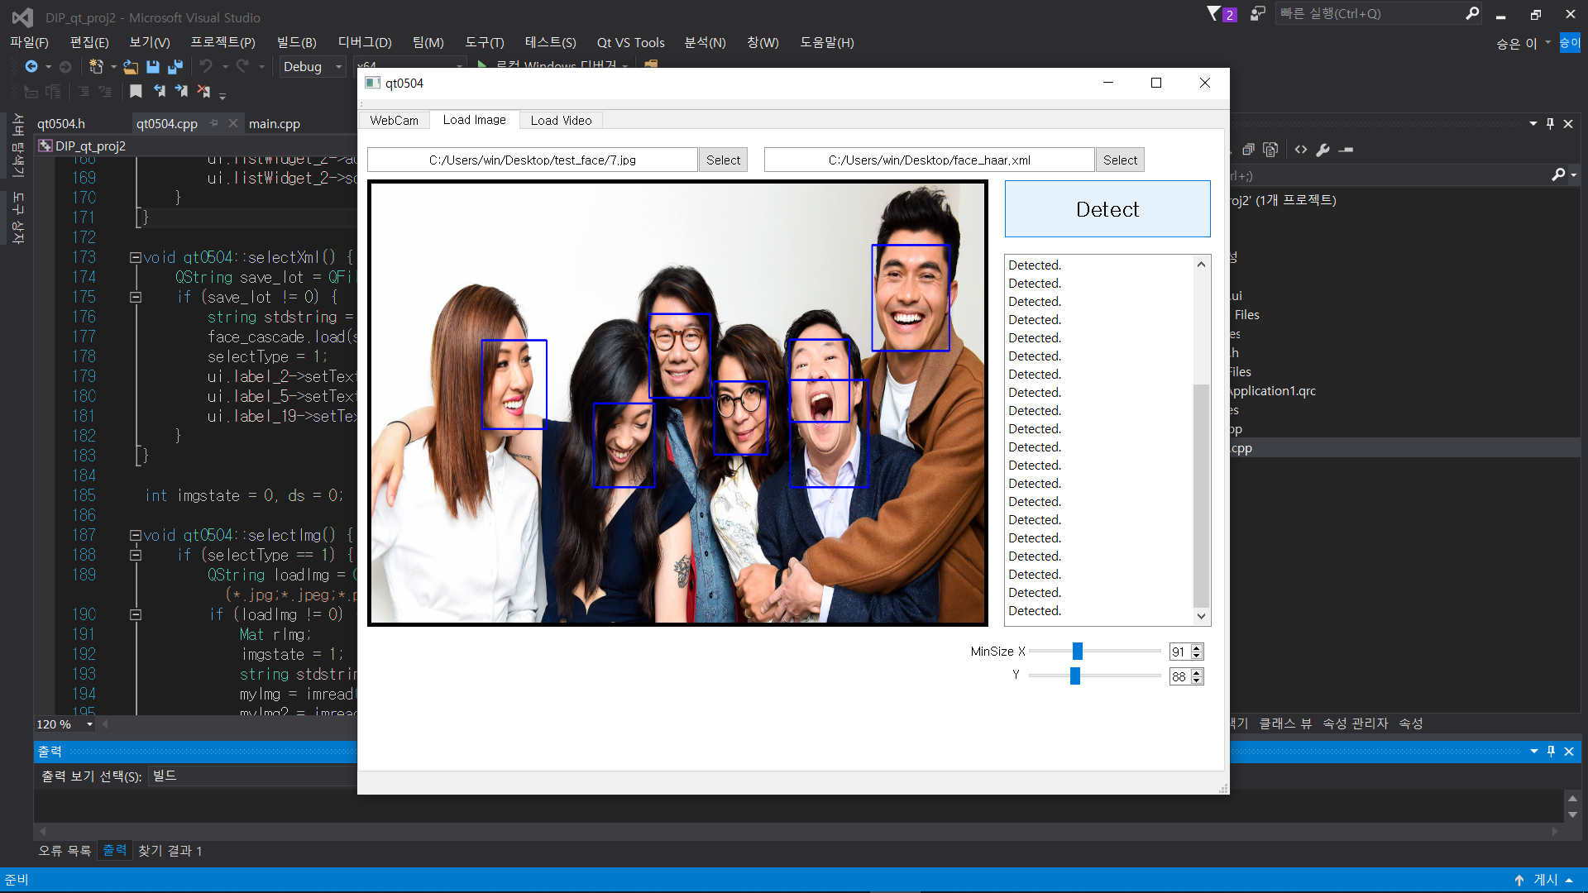
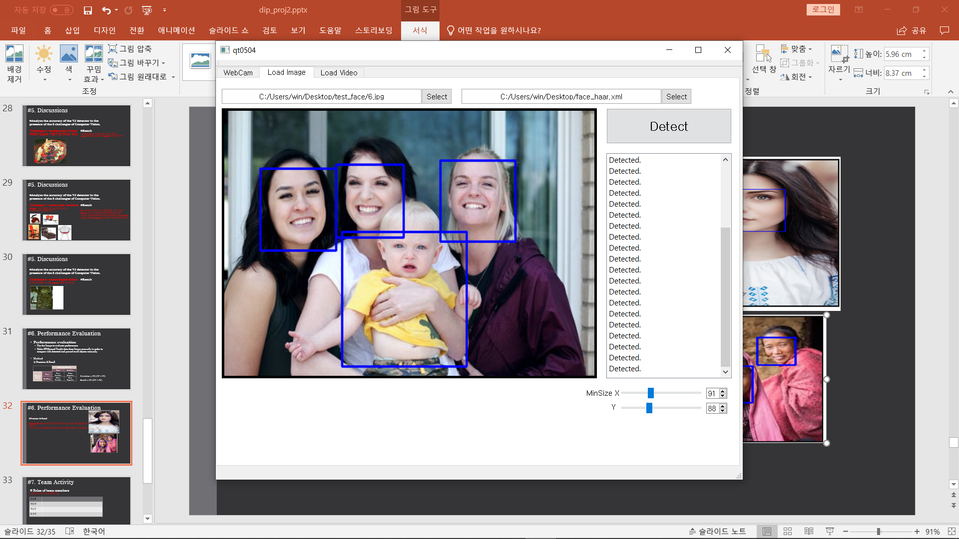
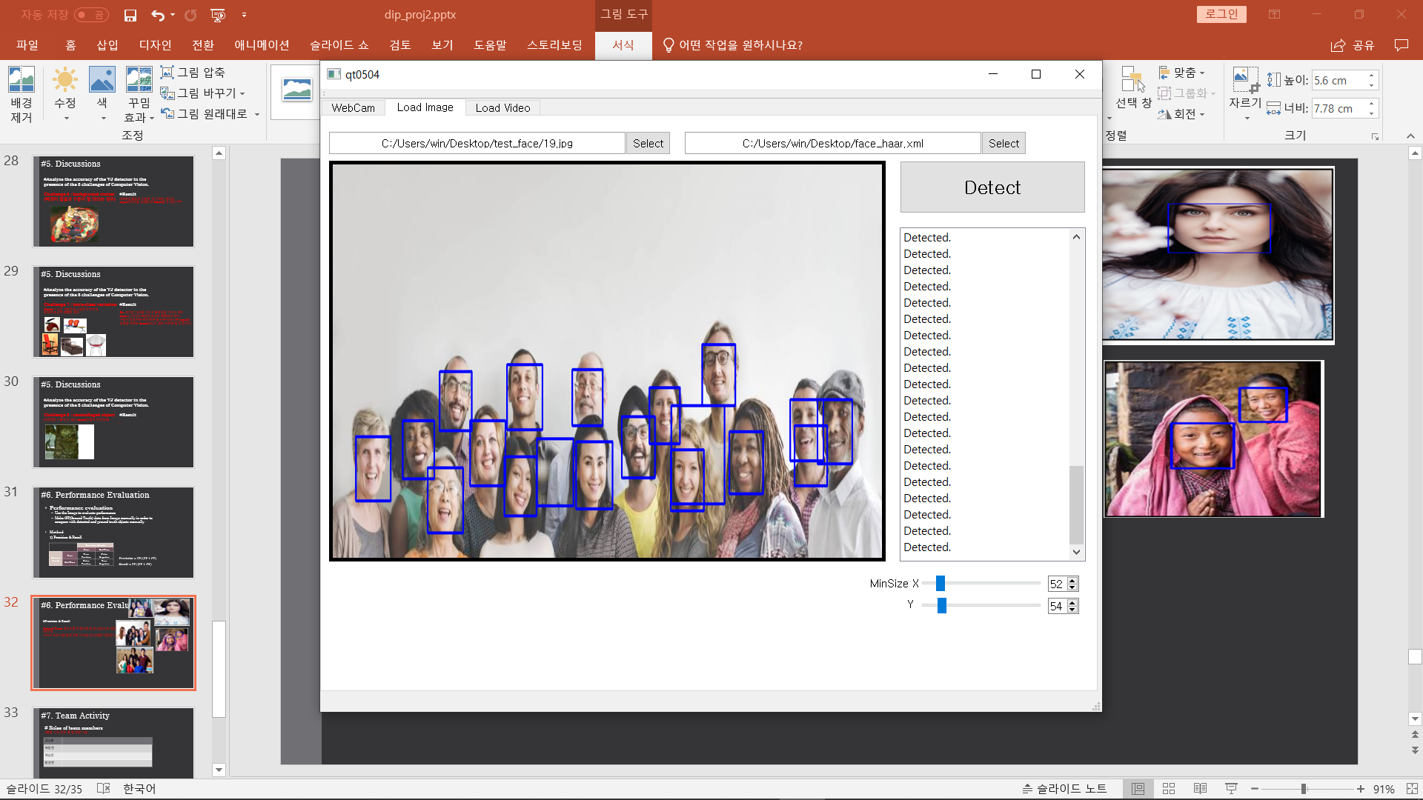
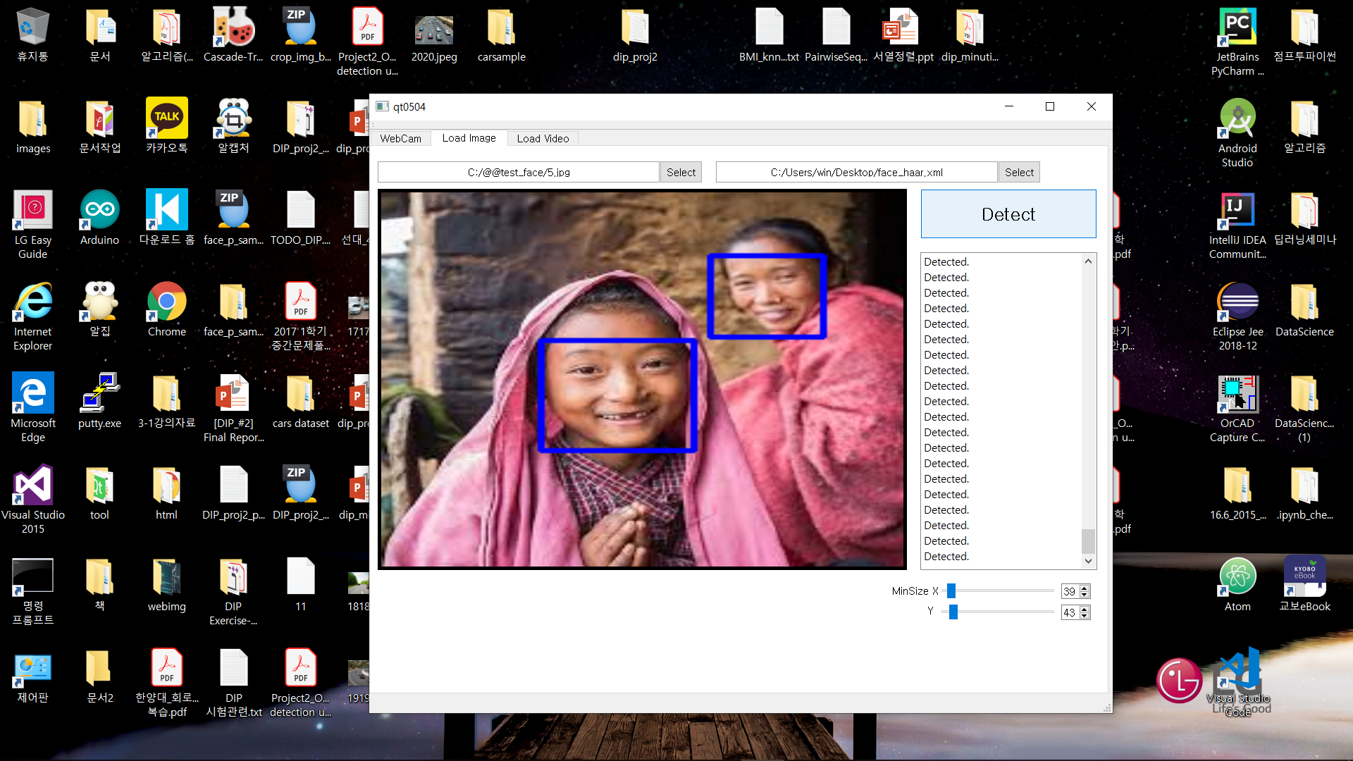
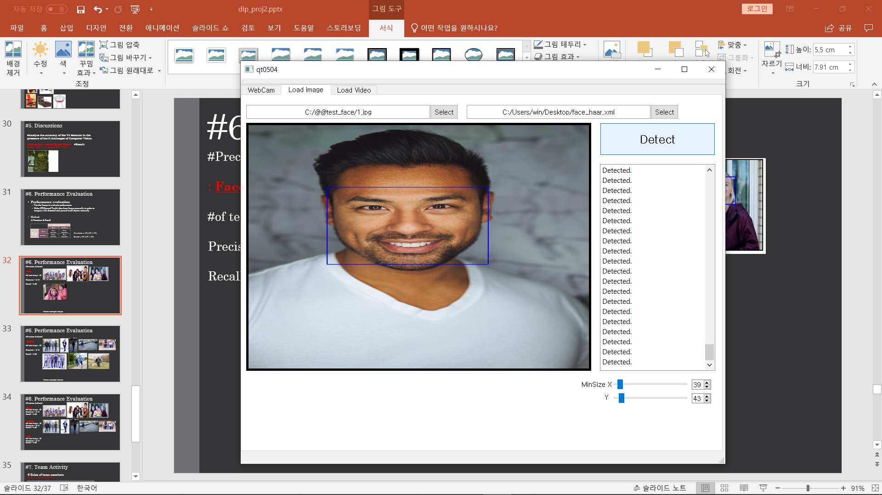
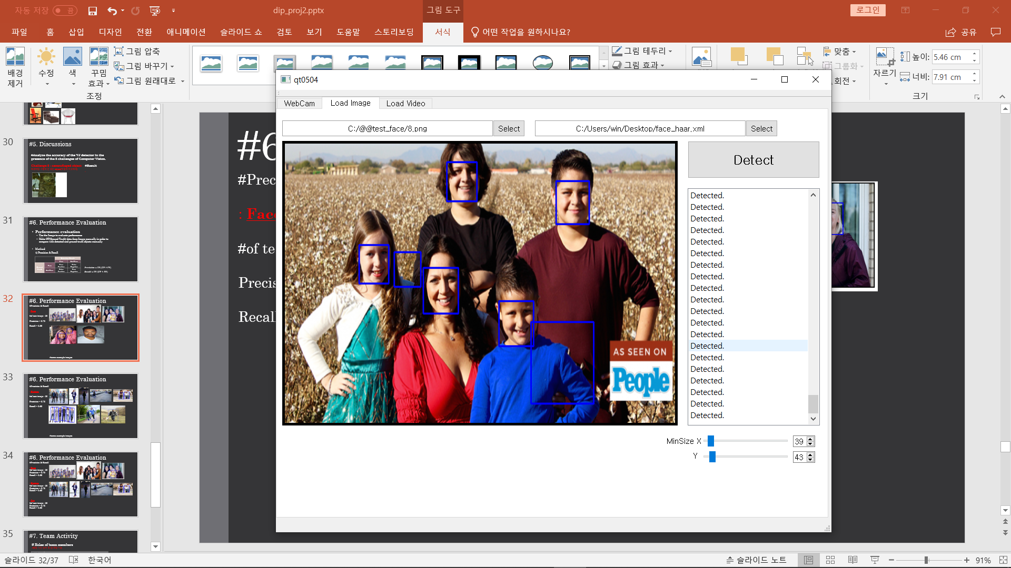
#6. Performance Evaluation
#Precision & Recall
: Face
#of test image : 20
Precision = 0.79
Recall = 0.88
#some example images

Slide 14
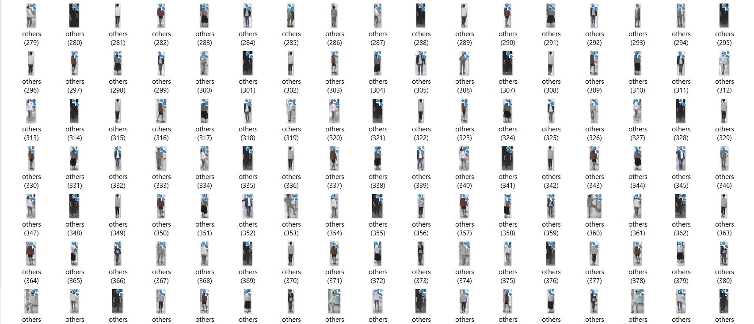
#Problem 2.(Human Detection)
Dataset
# of Positive | 1882
# of Negative | 18347
Width | 14
Height | 34
# of Stage | 19
Image Usage(%) | 85
Feature Type | HAAR
Source
http://pascal.inrialpes.fr/data/human/
https://drive.google.com/open?id=1cy2hma1uDiBKbeRXeBz6AMyg8M708vRx
https://www.shutterstock.com
https://www.unsplash.com
https://www.kaggle.com/
https://www.google.com
Our Photo

Slide 15
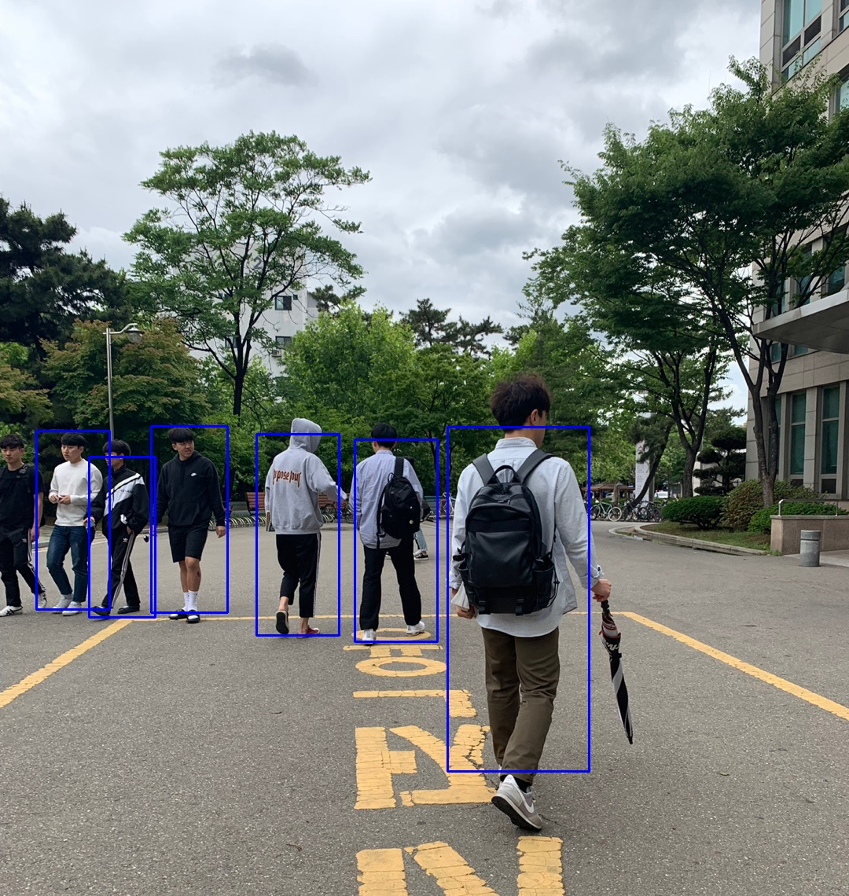
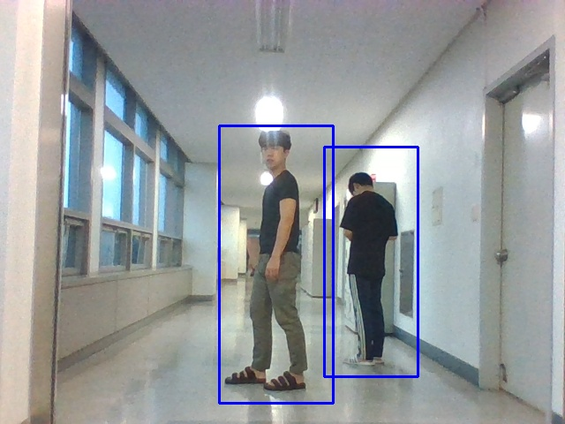
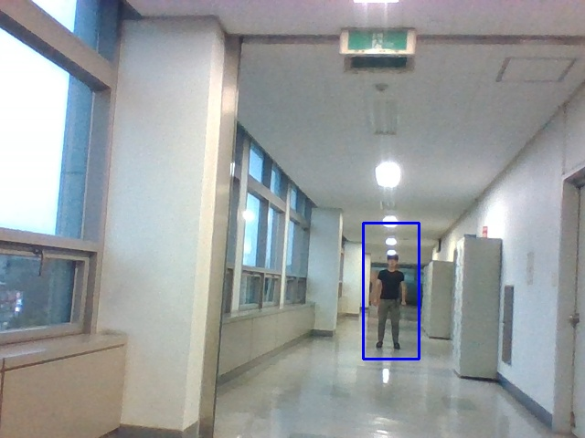
#Problem 2.(Human Detection)
Problem 1 & 2 & 3: Find the minimum and maximum detectable size of faces
Image Size | Minimum size of Detect scale | Minimum detectable size of faces | Maximum detectable size of faces | Average time
640 x 480(webcam) | 200 x 200 | 106 x 256 | 156 x 372 | 0.024535 s
640 x 480(webcam) | 100 x 100 | 106 x 252 |  | 0.030646 s
640 x 480(webcam) | 30 x 30 | 58 x 146 |  | 0.252391 s
1080 x 1440 | 80 x 80 |  |  | 0.402026 s

Slide 16
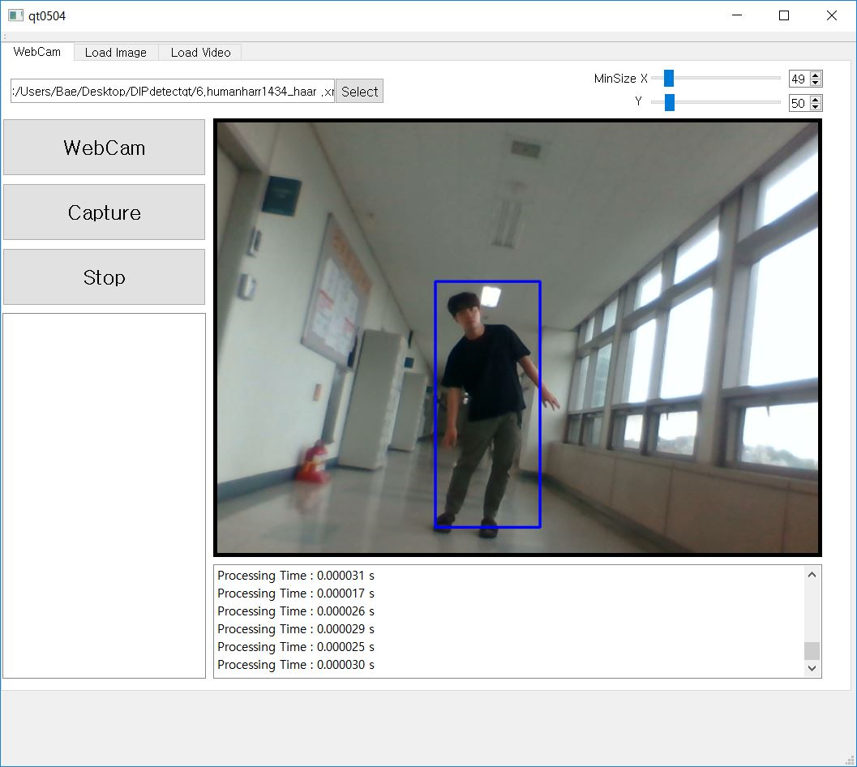
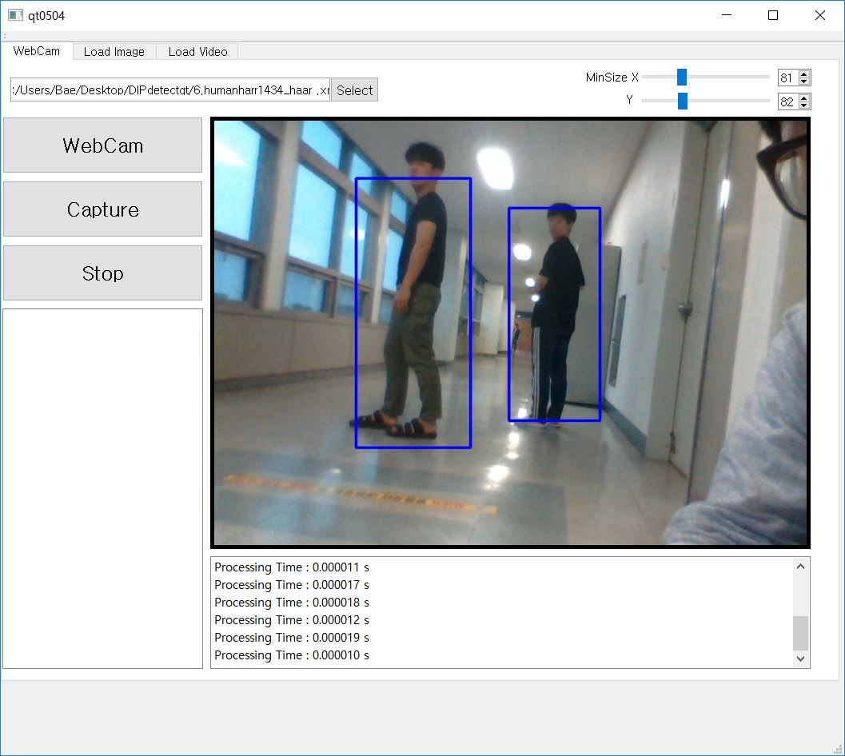
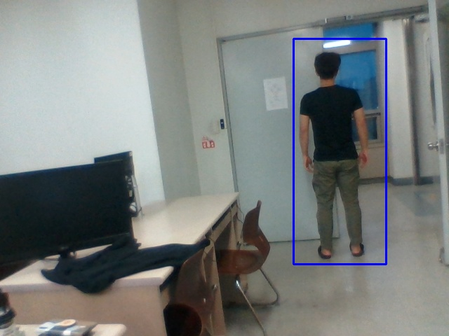
#Challenge #1 (Human Detection)
(View Point Variation)

Slide 17
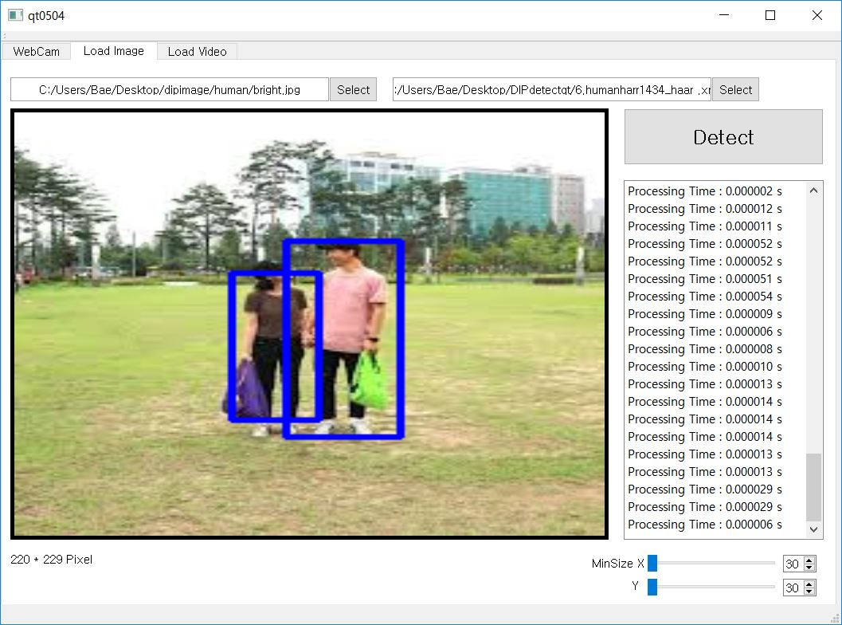
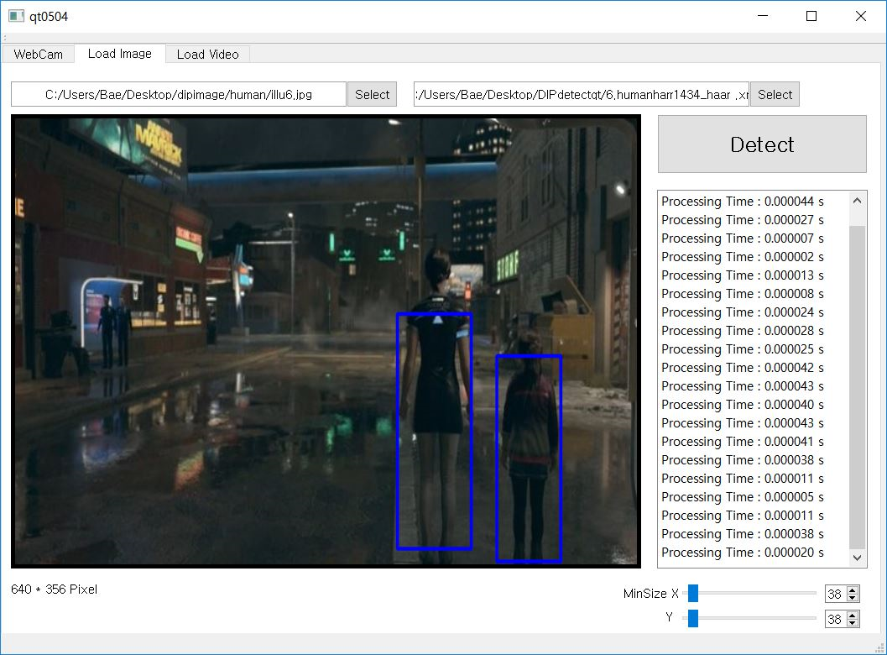
#Challenge #2 (Human Detection)
(Illumination)

Slide 18
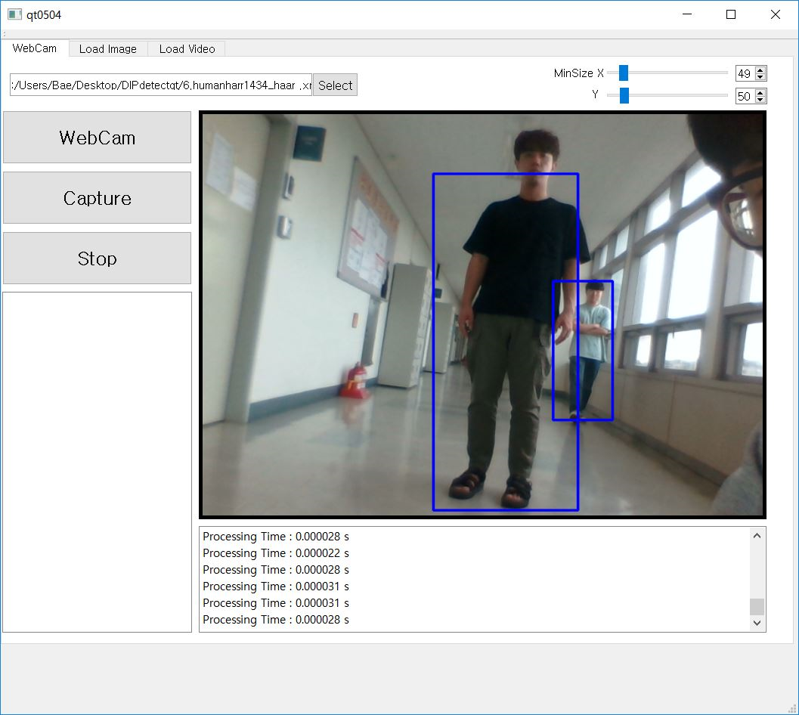
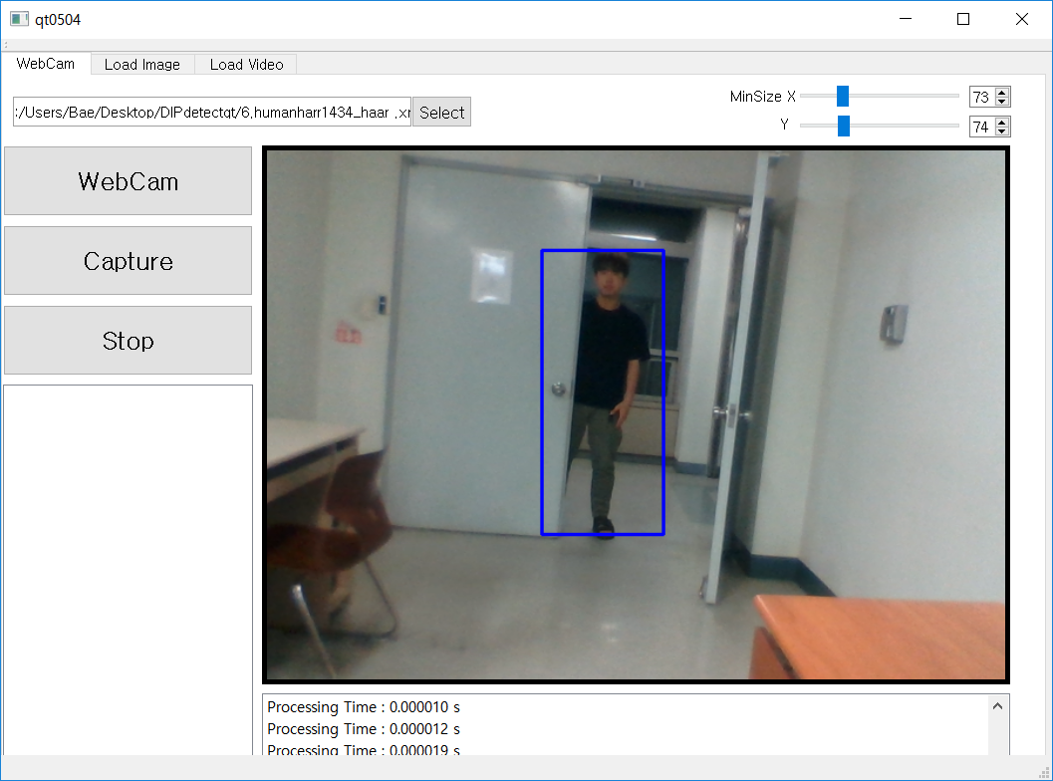
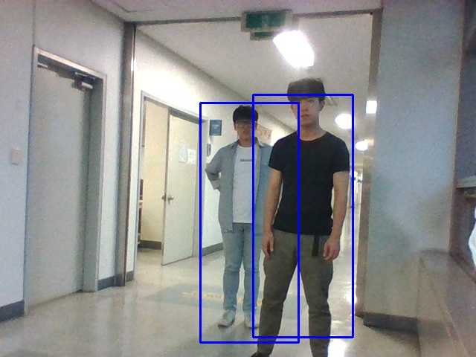
#Challenge #3 (Face Detection)
(Occlusion)

Slide 19
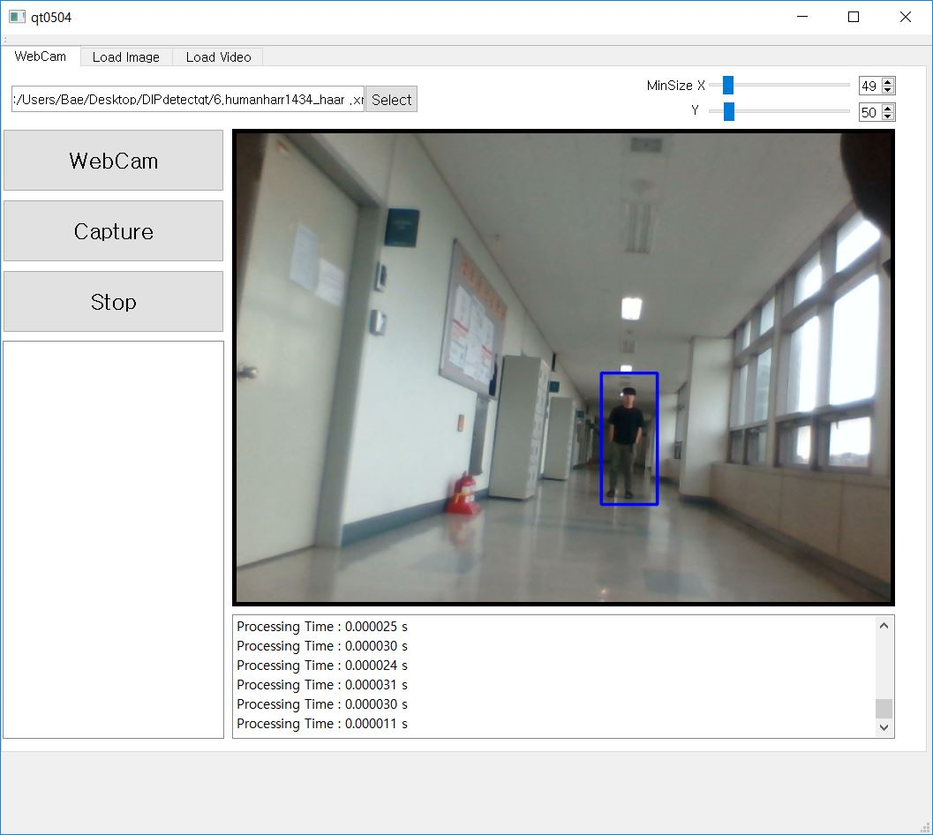
#Challenge #4 (Human Detection)
(Scale)

Slide 20
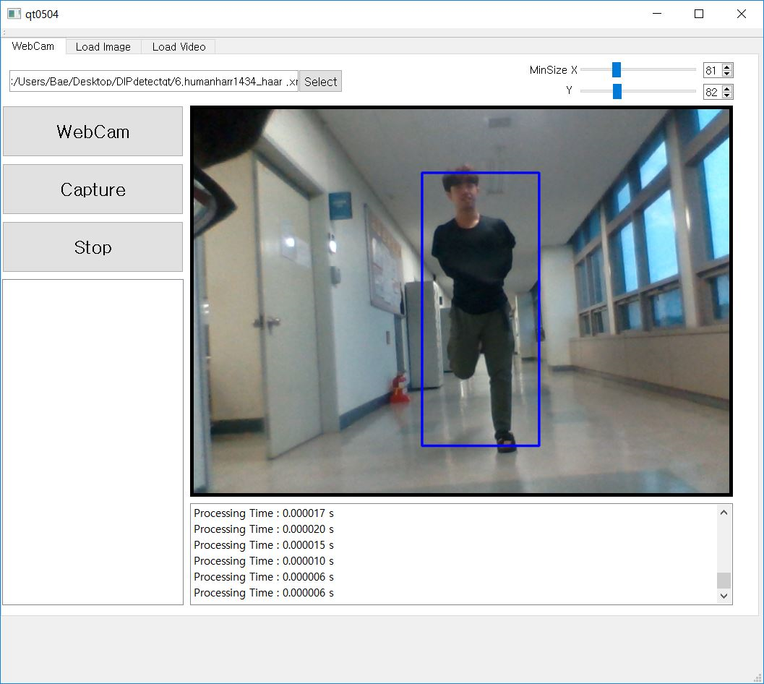
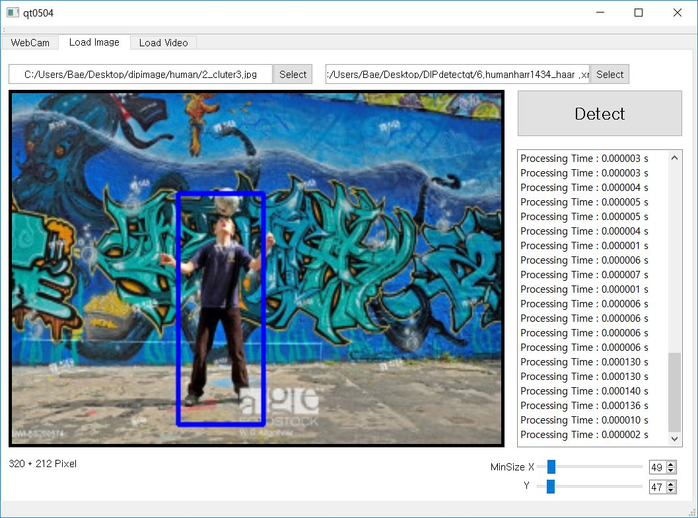
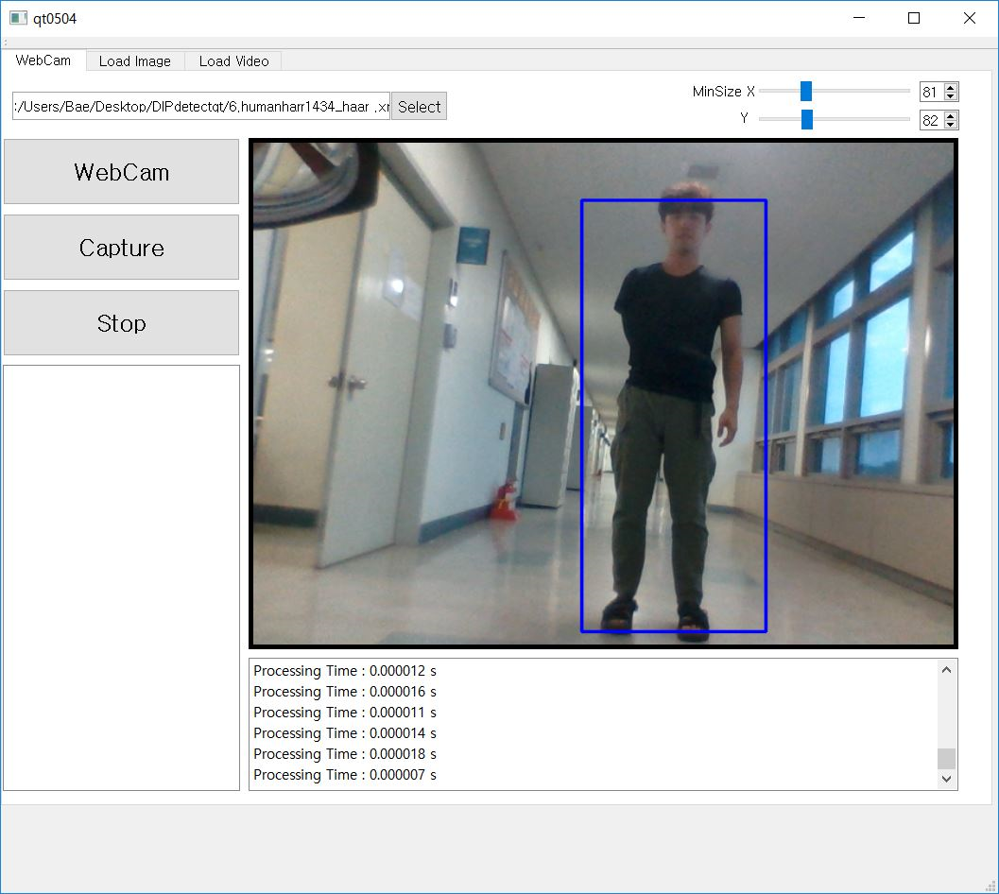
#Challenge #5 (Human Detection)
(Deformation)
#Challenge #6 (Human Detection)
(Background Clutter)

Slide 21
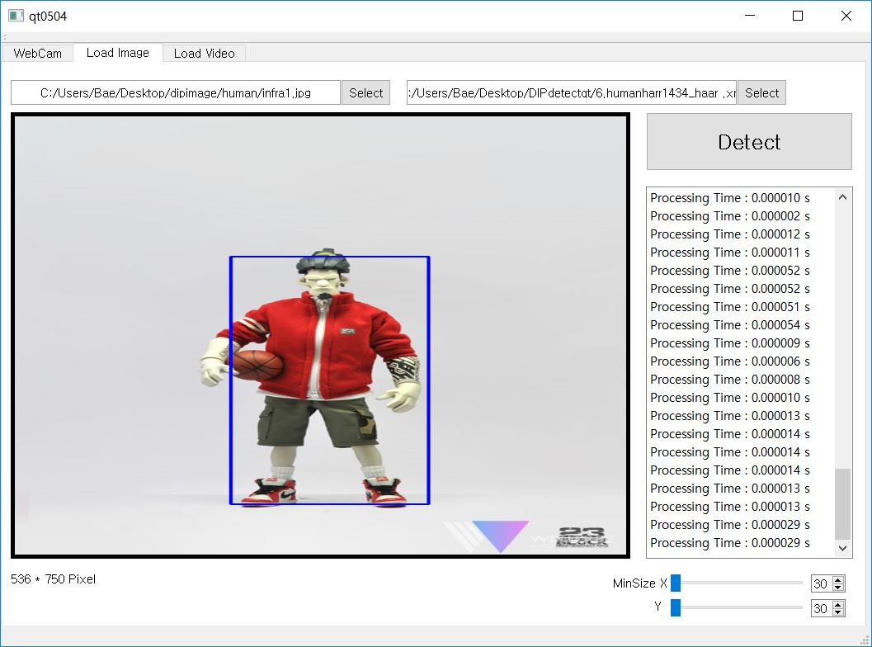
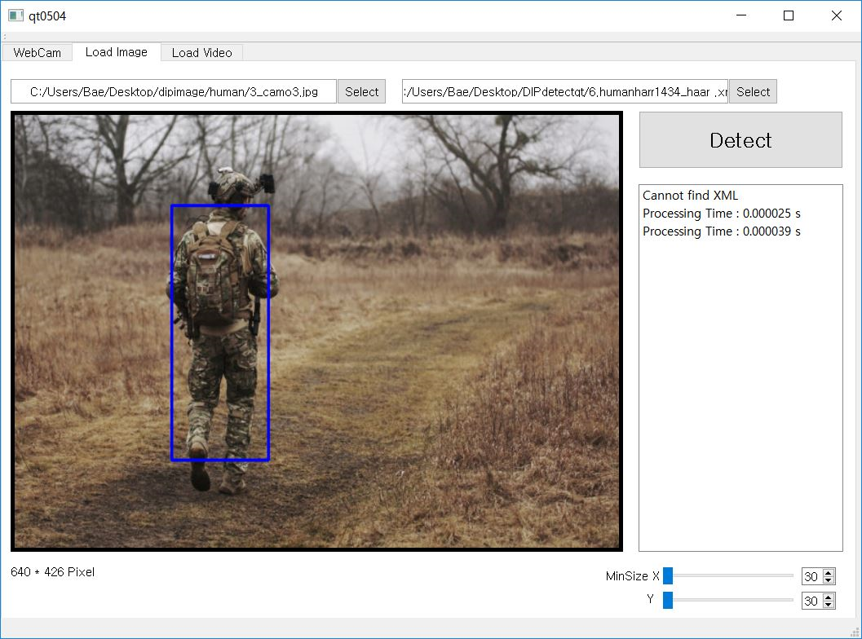
#Challenge #7 (Human Detection)
(Intra-Class Variation)
#Challenge #8 (Human Detection)
(Camouflaged)

Slide 22
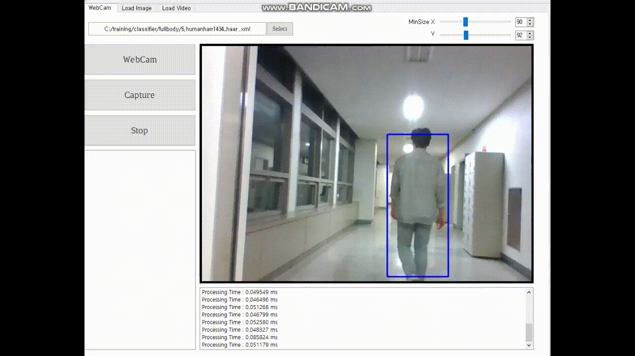
#Challenge #9 (Human Detection)
(Real-time Processing)
GIF

Slide 23
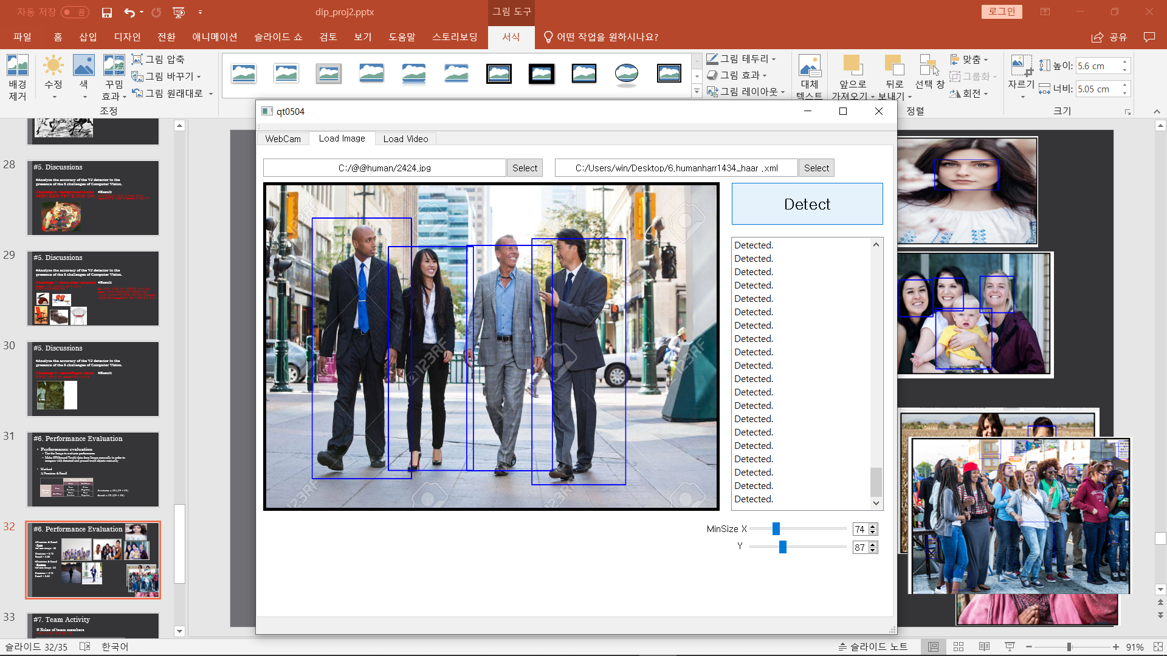
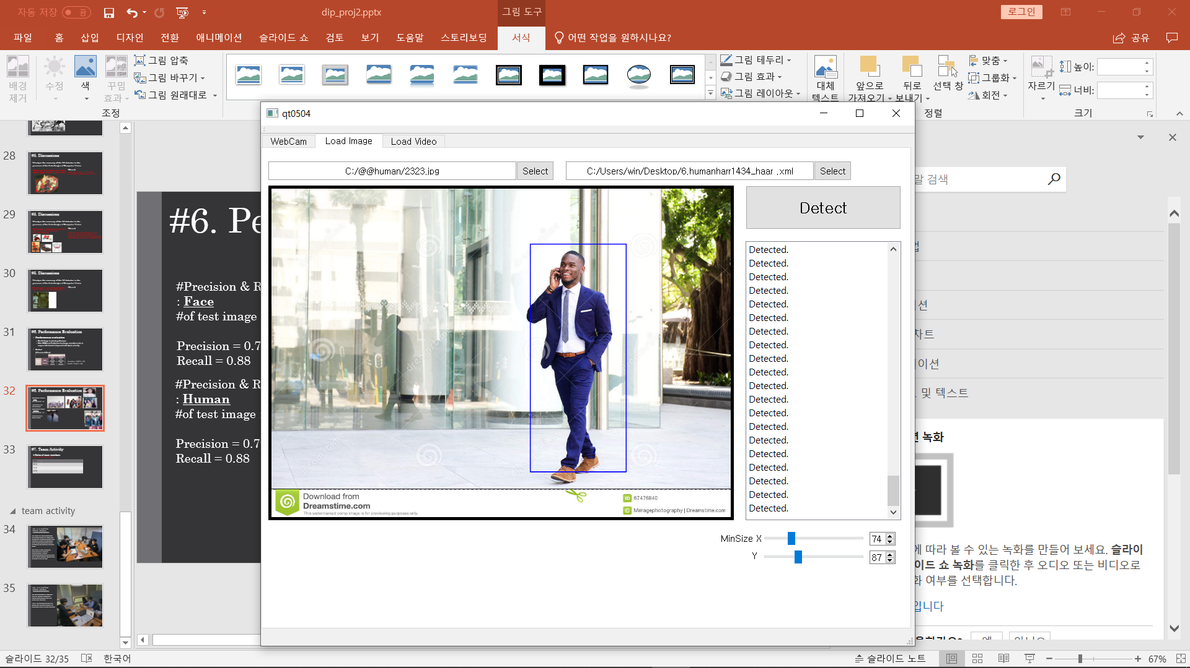
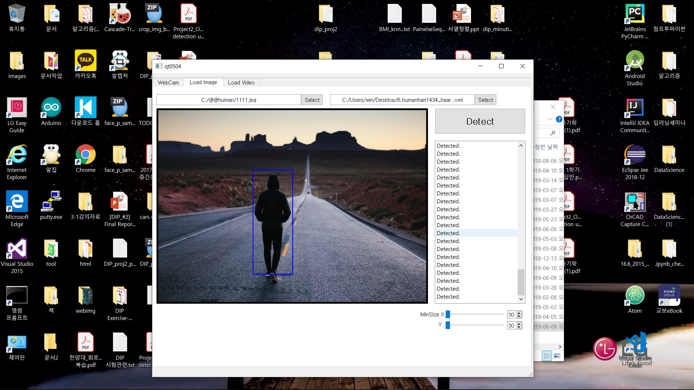
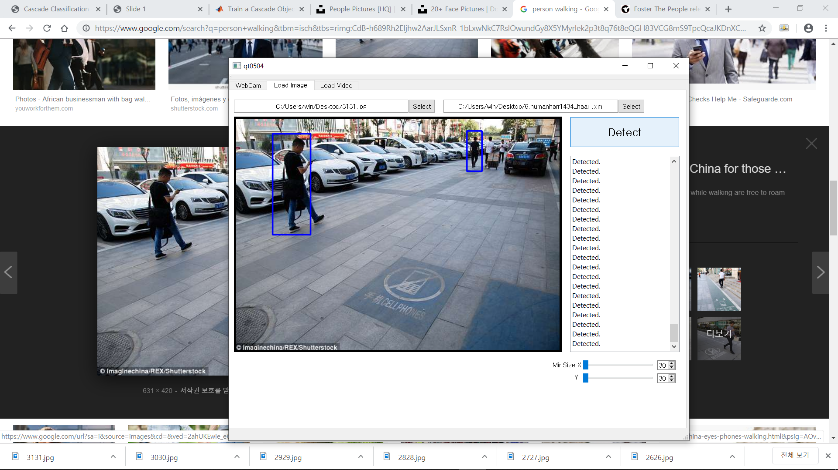
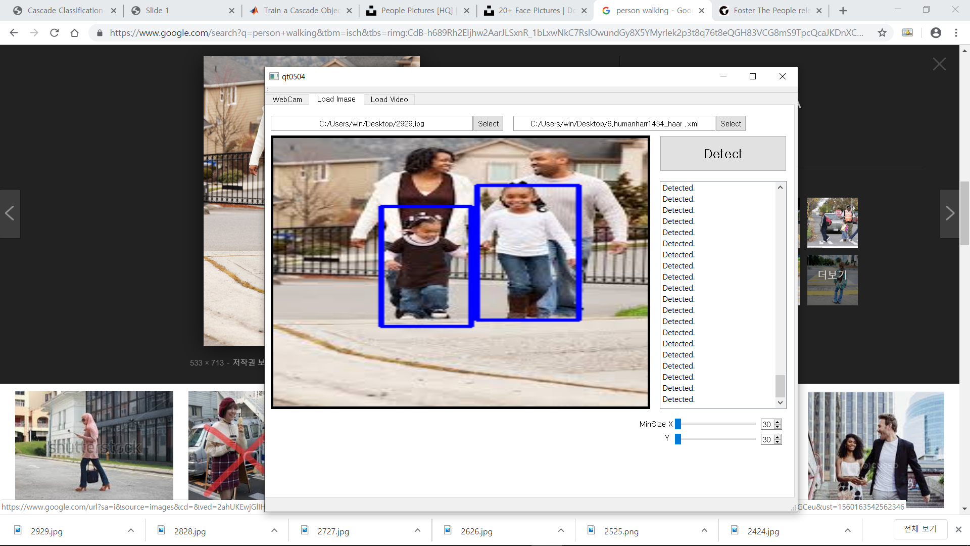
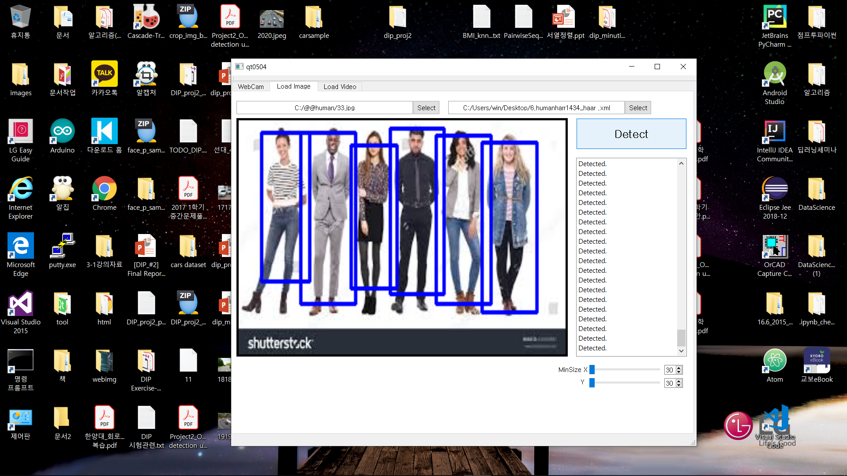


#6. Performance Evaluation
#Precision & Recall
: Human
#of test image : 20
Precision = 0.78
Recall = 0.63
#some example images

Slide 24

#Problem 2.(Human Detection)
Dataset
# of Positive | 2004
# of Negative | 22797
Width | 24
Height | 20
# of Stage | 17
Image Usage(%) | 85
Feature Type | HAAR
Source
http://pascal.inrialpes.fr/data/human/
https://drive.google.com/open?id=1cy2hma1uDiBKbeRXeBz6AMyg8M708vRx
https://www.shutterstock.com
https://www.unsplash.com
https://www.kaggle.com/
https://www.google.com
Our Photo

Slide 25




#Problem 2.(Car Detection)
Problem 1 & 2 & 3: Find the minimum and maximum detectable size of faces
Image Size | Minimum size of Detect scale | Minimum detectable size of cars | Maximum detectable size of cars | Average time
800 x 540(image) | 30 x 30 | 72 x 60 | 144 x 120 | 0.060 s
900 x 507(image) | 30 x 30 | 96 x 80 |  | 0.086 s
1000 x 666(image) | 30 x 30 | 72 x 60 |  | 1.26 s
5479 x 3652(image) | 30 x 30 | 120 x 100 |  | 2.04 s

Slide 26



#Challenge #1 (Car Detection)
(View Point Variation)

Slide 27


#Challenge #2 (Car Detection)
(Illumination)

Slide 28


#Challenge #3 (Car Detection)
(Occlusion)

Slide 29


#Challenge #4 (Car Detection)
(Scale)

Slide 30


#Challenge #5 (Car Detection)
(Deformation)
#Challenge #6 (Car Detection)
(Background Clutter)

Slide 31


#Challenge #7 (Car Detection)
(Intra-Class Variation)
#Challenge #8 (Car Detection)
(Camouflaged)

Slide 32

#Challenge #9 (Car Detection)
(Real-time Processing)
GIF

Slide 33



#6. Performance Evaluation
#Precision & Recall
: Car
#of test image : 16
Precision = 0.93
Recall = 0.73
#some example images

Slide 34

#5. Discussions
Q1. Can you decrease the minimum detectable size or increase the maximum detectable size? If yes, how?
1) Obtain a positive dataset of a small image , crop and train it.
(Or normalize the positive training data to a smaller size, Training.)
2) Using image pyramid, we can reduce the size of image and increase the
Size of image. And then we can test the image by using xml file which we
make before with cascade trainer GUI
3) If we use the camera which has high resolution, we can detect large size of object.

Slide 35


#5. Discussions
Q2. Is the detection time
dependent on the size of input image?
It is dependent. Detection in larger images takes longer.
This is because if the number of pixels in the image increases,
the detection takes a long time.
700 x 420 Pixel
Processing Time : 0.621215 s
2560 x 1536 Pixel
Processing Time : 12.726182 s

Slide 36


#5. Discussions
Q3. Is the detection time dependent on the number of faces(vehicles) in the image? Verify your answer.
If there are many objects in the Image which we want to test, cascade classifier which we make before try to detect each kinds of object by using all of stage. There are a lot of steps involved in finding the right image. So that, it is dependent
2560 x 1536 Pixel
Processing Time : 3.293012 s
2560 x 1536 Pixel
Processing Time : 12.230108 s

Slide 37
# Roles of team members
Name | Common Role | Personal Role
김승환 | Collect Data, ROI Crop | -Training classifier -Create Report -Evaluation
배동현 |  | -Training classifier -Create Report -Evaluation
이승은 |  | -Create Report -Evaluation
Reader 황성현 |  | -GUI Programming by QT -Create Report

Slide 38



Date : 6 / 6 (17:00 ~ 03:00)
Location : ICE CAFE
we collected positive and negative datasets for training in website.
And then we took some pictures for a challenge for our tasks.(Part of face detection and Human detection)
First, we tried to run cascade classifier by using LBP. and we can get some normal result for detecting object.
And we run cascade training by using HAAR. Because It takes much time over 20 hours.

Slide 39

Date : 6 / 9 (15:00 ~ tomorrow 05:00)
Location : HI-TECH-424
Finally we opened our *.xml source file in the visual studio for testing our program is doing well.
Some of files are good, and few are not good. We modified our sample for good result of cascade training.
During waiting time for modified *.xml file, we make some presentation file for our report.
Finally we can get good *.xml source file and we did all of challenge and report that in our ppt.

